Slide 1
Phoodie: Restaurant Point of Sale System

Slide 2
Roles
Mel - QA, Development Engineer, Project Manager
Anthony - Development Engineer
Tim - Requirements Engineer, QA
Mitch - Requirements and Development Engineer

Slide 3
Requirements
Previous:
Front of House Interface
Order Food
View Menus
Tim Parzynski

Slide 4
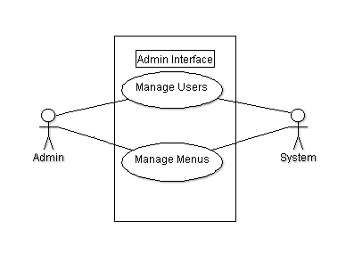
Requirements
Current:
Front of House Interface
Seating
UML Use Case Diagrams
Tim Parzynski

Slide 5
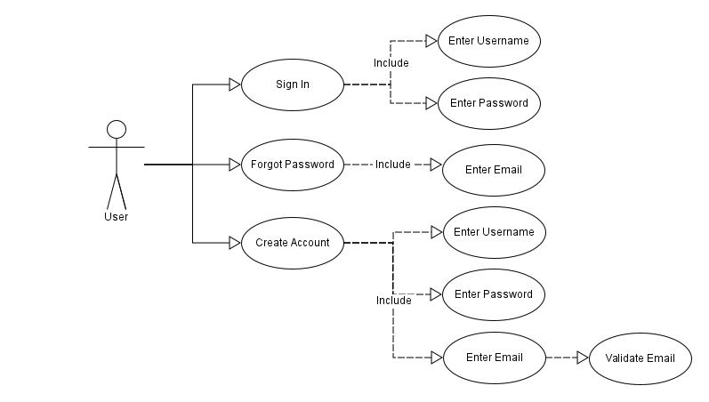

Slide 6
Requirements
SRS Product Functions
Wait staff will be able to
view seating
assign guests to seats
remove guests from seats
Additional Functionality (Future)
Show available seats per table
Display whether or not guest have paid
Mark which tables need to be bused
Tim Parzynski

Slide 7
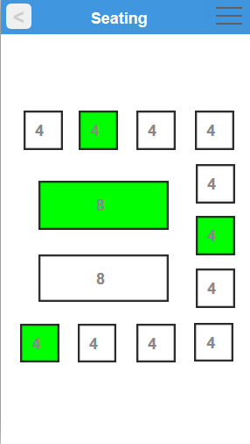
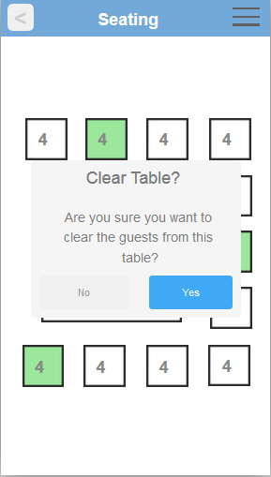

Slide 8
Development: Front End
Current:
Upgraded Order Queue for better functionality
Implemented new security into AJAX calls
Added menu editing(buggy) and adding to the admin page
Did not finish seating page
only implemented JQuery-ui draggable function to page
Some bug fixes
Mitch

Slide 9
Development: Back End
Security:
Previous:
Bare Minimum after our server was used for DDOS
Passwords stored directly in database
Username/password stored unencrypted in cookies
Current:
Passwords are now hashed with a salt
After login, salted & hashed password stored in cookies
Even if compromised, not useful after next legitimate login
New logins override previous logins
Miscellaneous:
Began working on ability to upload images
Used for menu items, etc.
Bug fixes
Anthony

Slide 10
Development: Servlets Using Procedures
Current:
Admin
Add Restaurant User
Add Menu
Add Menu Item
Change Menu
Change Menu Item
Change Restaurant User
Delete Menu
Delete Menu Item
Delete Restaurant User
Get Restaurant User
Detail Status Changed
List Menus
List Restaurants
Anthony, Mel

Slide 11
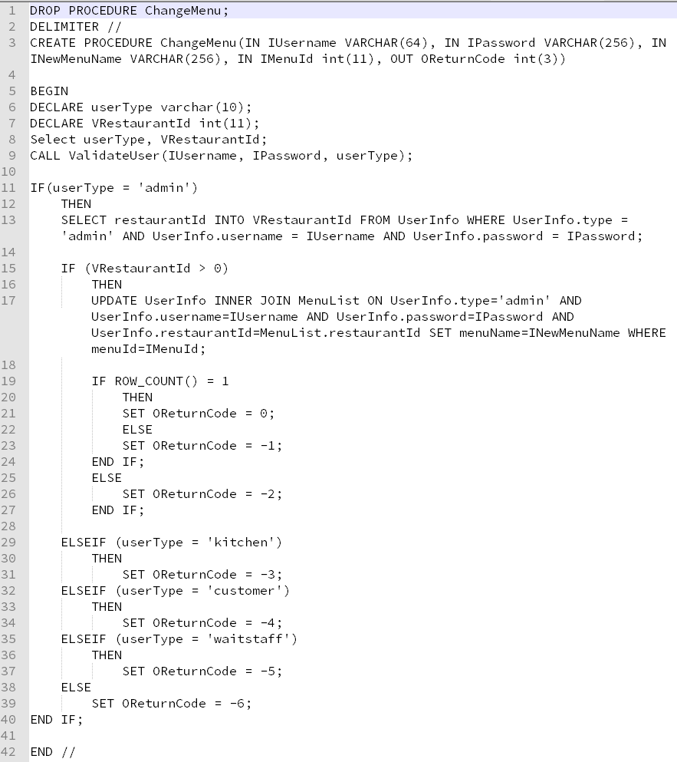
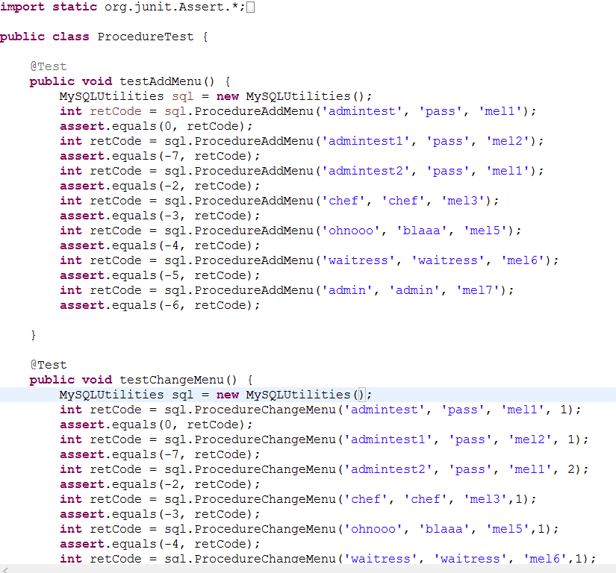
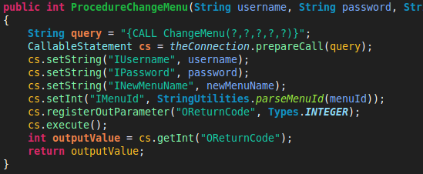
Development: Servlets Using Procedures

Slide 12
Development
Future:
Continue creating MySQL procedures due to new security features
Finish implementing the picture uploads to allow pictures for menu items.
Table Grid Development 50x50 was too much work and organization
Mel, Mitch, Anthony

Slide 13
QA
Last Time:
Admin Interface and Server Tests
Front of House Interface and Server Tests
Current:
New Tests and Revising tests due to new security features and Procedures implemented.
Found out some of the old tests didn’t work due to some issues with the new procedures
Recommended JUnit Testing on Procedures
Mel (week 1)
Tim (week 2)

Slide 14
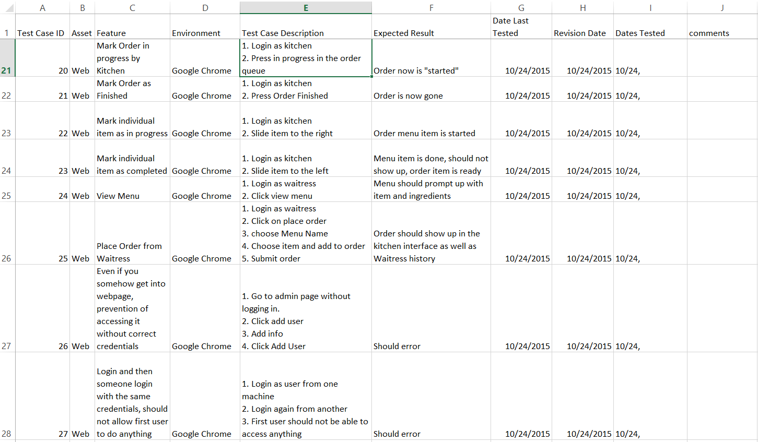
QA
Mel (week 1)
Tim (week 2)

Slide 15
Project Management
Current:
Security improvements
QA is finally up to date
Sleeker UI (Better options for orders and history)
3/4 Procedures Done and Tested
We are behind by about 3 days:
Front End Stuff was not working correctly after some QA testing
Lots of test cases for Junit Tests
MEL CHI

Slide 16
Project Management
Next Week:
Add additional columns and tables in preparation for Maps and Paypal API
Paypal and Google Maps API Research and Start of Implementation
Picture uploading to database functional
Finish other last parts of Procedures creation and Testing
MEL CHI

Slide 17
Schedule (Previous)
Date | Iteration | Goals
10/15/2015 | 3 | Host(ess)/Waiter(ress) Food Ordering Servlets Functionality Finished Main Tables for FOH Interface Start Procedures for more complex SQL, or multiple queries in one action
10/22/2015 | 4 | Security improvements, QA, Sleeker UI More Procedures
MEL CHI

Slide 18
Schedule (Current)
Date | Iteration | Goals
10/29/2015 | 4 | Security improvements, QA, Sleeker UI (Better options for orders and history), Continue Procedures
11/5/2015 | 5 | Finish the picture uploads functionality for Sleeker UI Finish Procedures of what we have Look into Paypal API and see what we have Look into Google Maps integration as well as potential timing for orders to be completed.
MEL CHI

Slide 19
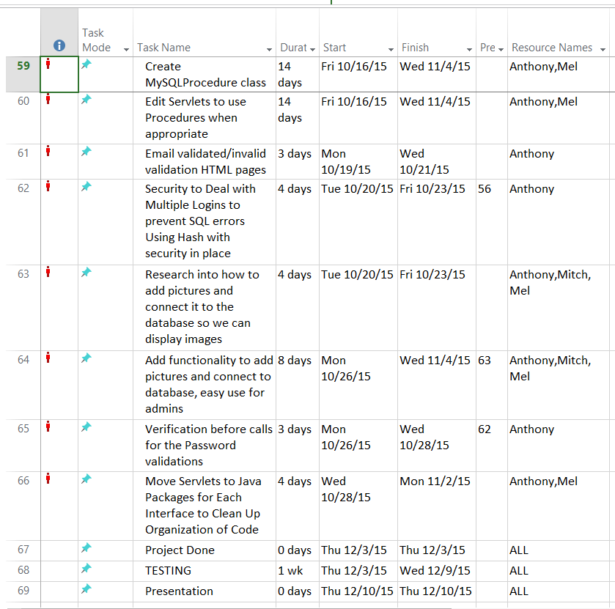
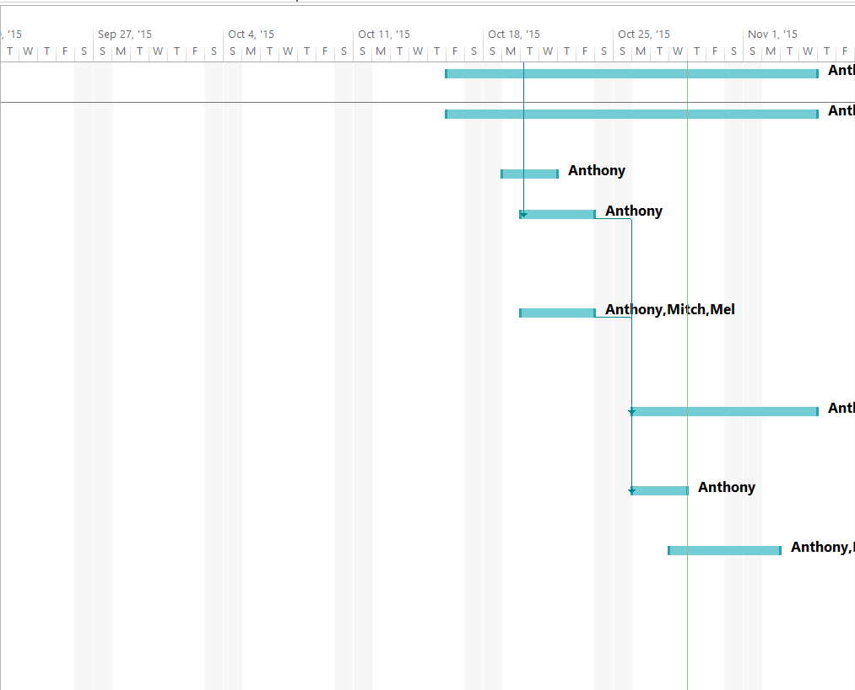
MEL CHI

